Slide 1
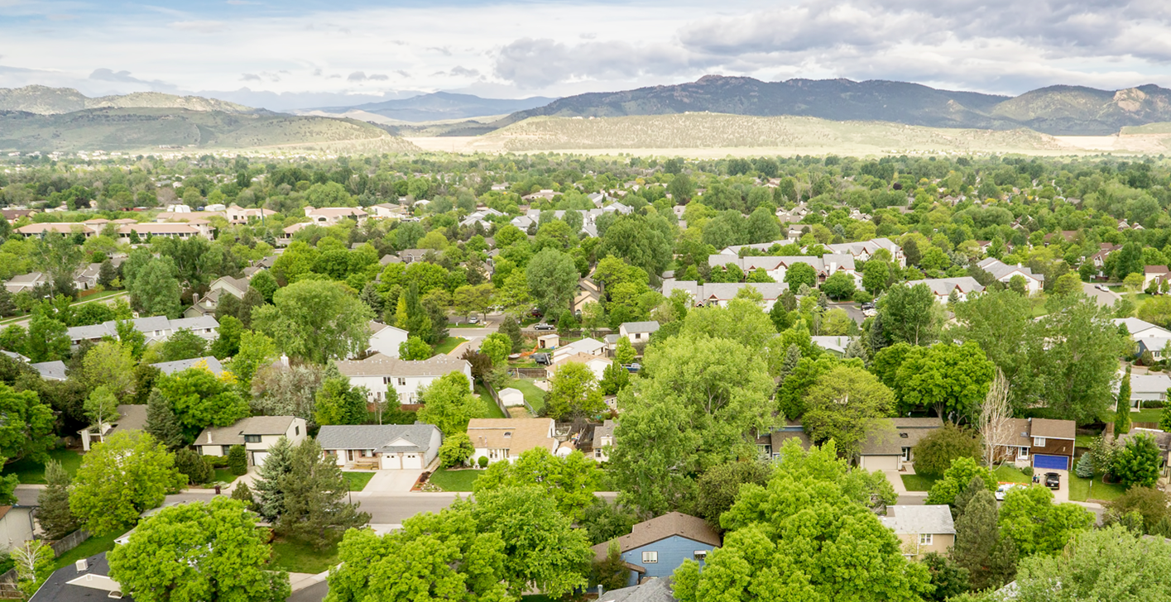
Annie Bierbower – Civic Engagement Liaison
Recruiting and Engaging
Hard to Reach Populations

Slide 2
Representation of the Community
PSD Student Demographics 2016
Notes:
Census Data is out of date
City has a demographic page
PSD breaks down demographics by school and provides a public and provides Annual Report
United Way researches poverty and data in the county
Center of Migration Studies

Slide 3
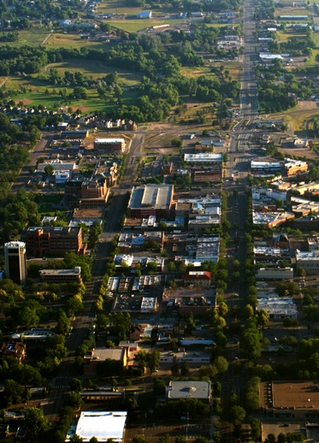
Representation of the Community
Estimated populations: 167,500
Median age: 29.3
Almost 31% participate in Free/Reduced Lunch
Between 3,00 and 4,000 undocumented people
Approximately 3,200 children live in mixed status homes
Colorado poverty level for a family of four: $24,250
Larimer County 1 in 7 people live in poverty
Notes:
National median age about 38% so we are very young
A little old for “college town”

Slide 4
Who Is Hard to Reach?
Everybody vs. nobody
Cultural and linguistic needs and backgrounds
Refugees and immigrant families
Youth (high school, college, young professionals, elementary, at risk)
Low income or living in poverty
Single parents
Business owners and/or developers
People with disabilities
Elderly (60+)
Families with protection or safety concerns
Geographically isolated (transportation, road quality)
Technologically isolated (low quality Internet device or unreliable access)
Educational background
New to the community
Caretakers
Notes:
Huge list
Barriers: social circumstances, characteristics and behaviors, institutional relationships, cultural diversity, language and education levels – often cross over of barriers
Begs the question, “who is easy to reach?”
Do you have groups of people that are completely available and ready to go at a moments notice?
Depending on the context this can expand into things like service resistant and cross over of barriers, low income fathers, etc.
You will not develop and relationship and make progress unless you determine who is your hard to reach, prioritize groups, and make customized communication plans based on the interests, barriers, and needs of this group – fact.
The City has broken youth into the three separate groups listed here and is focusing on Spanish speakers, high school students and low income families right now
Kind of like everything has its price, every person or group has an interest. Low income parents – how can we create or show a financial incentive or benefit to their children?
Single parents – how can we offer some support or make sure our volunteer hour feels like personal time for them?
Geographically isolated – what are the services nearby where we can hang fliers or try and build an ambassador relationship with, could we arrange a shuttle for a special volunteer opportunity out of that area?

Slide 5
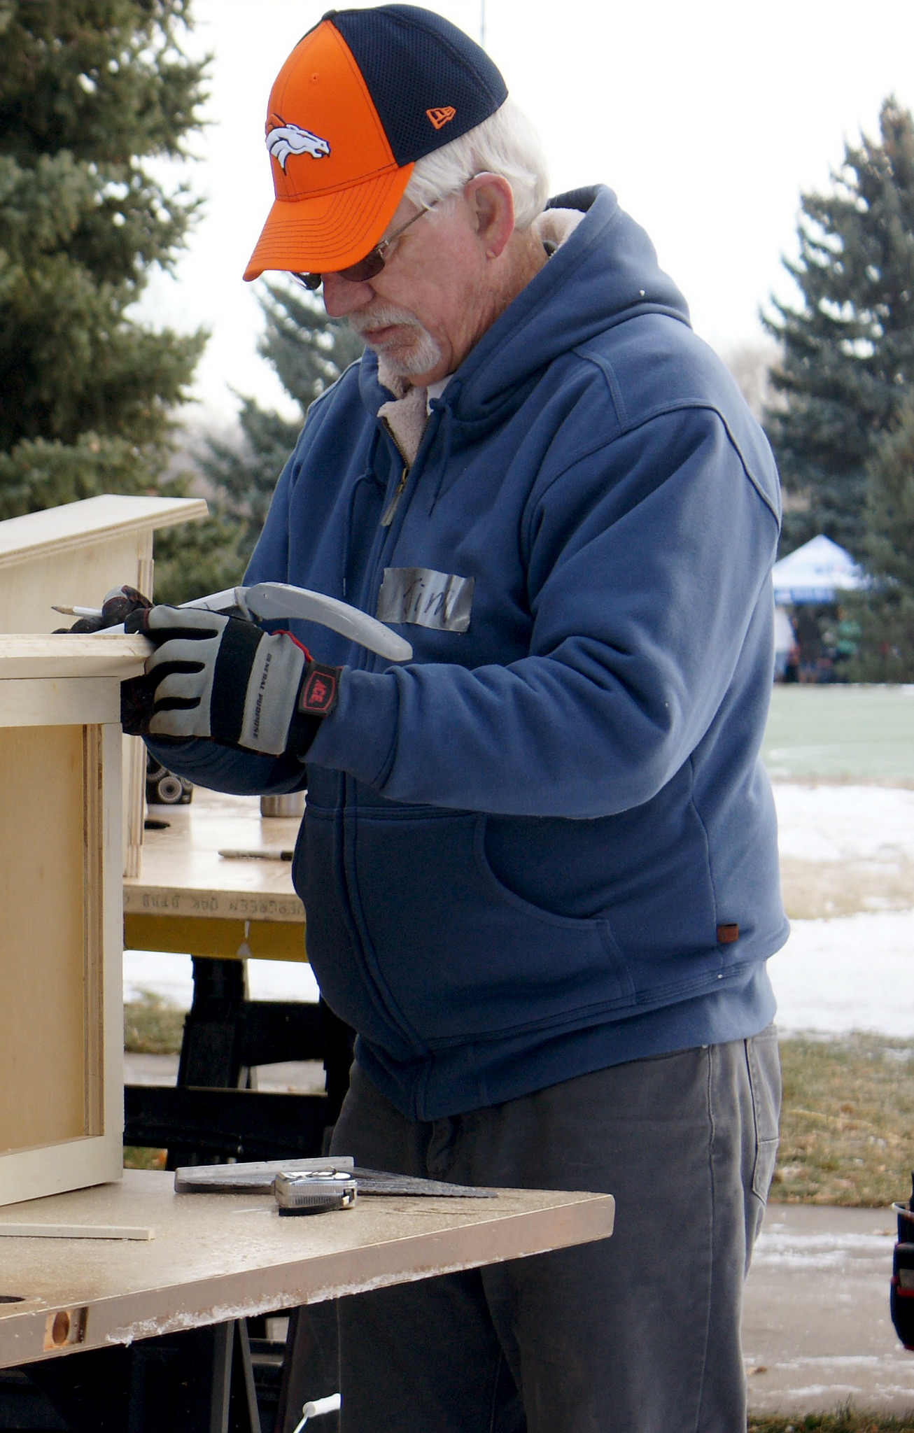
Why Do People Volunteer?
Cultural or community expectations
Organizational expectations
Gain or practice new skills
Professional networking
Personal responsibility
Make a difference
Socialize
Required

Slide 6
Why DON’T People Volunteer?
Minorities were not asked
Fear of being used as a token
Do not feel connected to the mainstream community
Lack of personal time
Emphasis of minority culture on family involvement over community involvement
Lack of identification with agencies that are serving minority clients
Lack of knowledge about volunteer opportunities
Belief that minority input is not taken seriously
Uncertainty about benefits
Economic hardship
Notes:
United Way of Santa Clara conducted research poll to gather insight on reasons minorities are less present in organized volunteering. This is what they found:
Maybe more importantly especially in terms of hard to reach is why don’t people volunteer?
We might be a slightly biased audience but there are a lot of benefits no matter what stage you are at in your life
Maybe even ESPECIALLY for some of these harder to reach groups that maybe need more support, or to develop skills, and gain community
The thing is some of these identified barriers are actually counteracted by volunteering
So how do we connect the dots? How do we let these audiences know that they are not only welcome and wanted but stand to make incredible gains

Slide 7
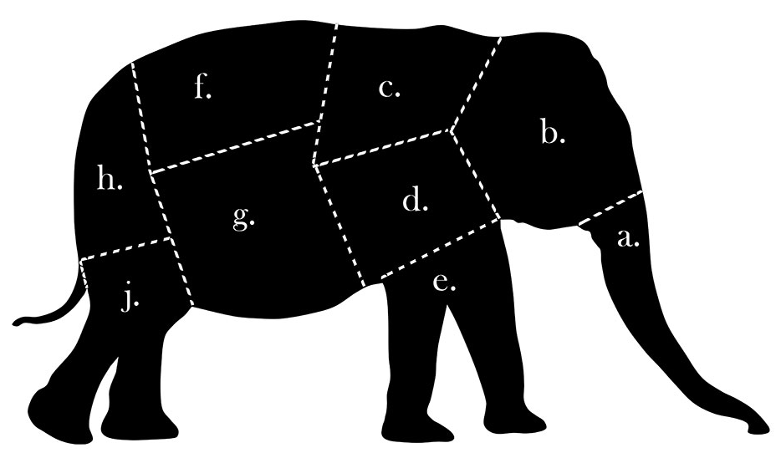
Know Your Audience
How do you eat an elephant?
If everything is italicized nothing is
Ultimately reach everyone but not yet
Who is missing and prioritization
Notes:
Look how bad this slide looks!
All italics a giant elephant butt?
The answer is we have to know our audience
It is wonderful to set a goal of reaching everyone and that can be the ultimate achievement but to get there you need to use data and record keeping to see who is missing and decide who you want to reach first
One piece at a time

Slide 8
Process, Data and Records
Follow up surveys at events
Required entry information
Organizational expectations
Standardized demographics
Channel analytics
Customized outreach – understanding your audience
Notes:
We covered already there a lot of organizations that can provide this for you already
Citizen Survey – we offer presentations and help cross sectioning the data if you would like
The saying if I could be a fly on the wall in that room. Media kind of lets you do that. Look up organizations/groups on all the social media platforms. What are they talking about? How many people engage on the different topics? What are they doing? Recommending to each other? You can do this on a more local level otherwise compiled reports are available about this all over the Internet.

Slide 9
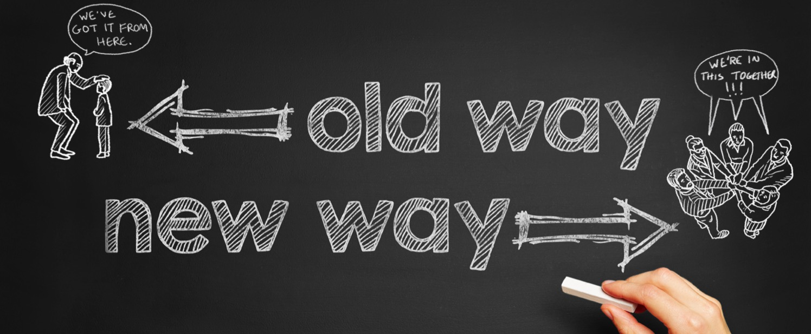
Reimagine Your Process
Notes:
Micro-volunteer on a smart phone some examples:
Translation, image/content tagging, editing, content creation, mapping, feedback
Smithsonian ex.
What tasks do you have that someone could do tomorrow, this afternoon, for 20 minutes? Even if they have to be trained short term opportunities can continue, maybe they will volunteer for 20 minutes 20 times
Are there options that parents can do with children
What opportunities don’t require language skills
What will make them feel like they are giving back to their direct community – minorities or harder to reach populations may feel disenfranchised so the thought of giving back to community they feel no connection to is not appealing
What is your structure?
What is your documentation?
Do people need background checks, if people are undocumented, know people who are undocumented or maybe even have some sort of temporary legal status, the idea of background checks and records can be an issue

Slide 10
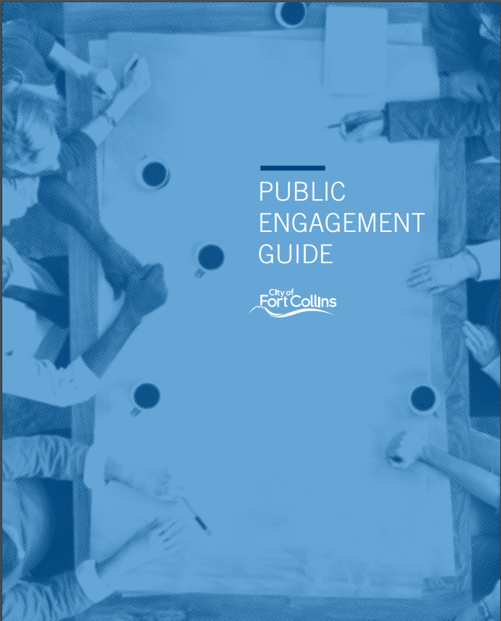
Systematic Engagement Planning
Notes:
Systematic tools and language
Trainings
About 30 staff members trained and certified in public engagement through IAP2 (International Association for Public Participation)
Transparency
Community partnerships (public private partnerships, organizations used as avenues of communication
Your voice is heard & considered
Managing expectations – be clear and honest when a project is at the Inform & Consult level vs. the collaborate level
Project go more smoothly when the public is aware and included
Other tools that we’ll use today

Slide 11
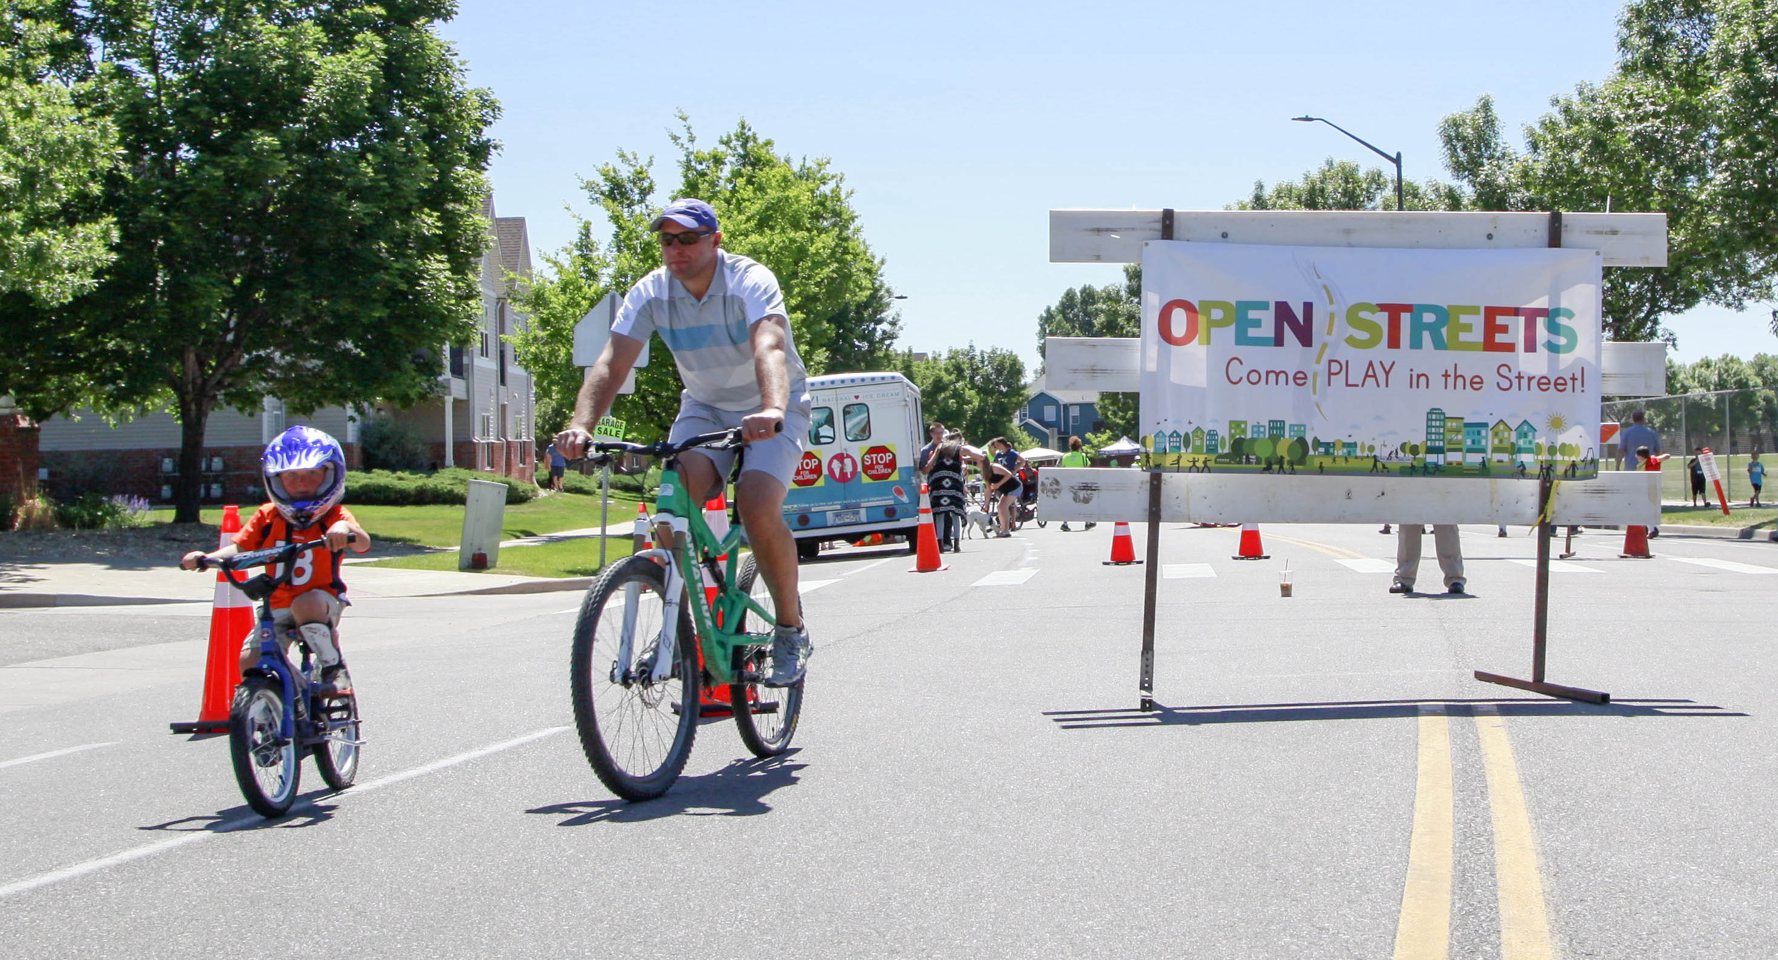
Where are they?
Organizations for almost anything
Cultural, faith, interests
Specialized Media Outlets
Minority/specialized retailers
Grocery stores
Gaming stores
Service Providers
Ask for contacts
Build relationships
Notes:
Meet them where they are and partner
– if you provide a service that another organization can get behind, they may be able to gain permission from their clients/patrons to share their contact potentially result in a list of people to personally reach out to and an introduction from a trusted source
Incentives for members of hard to reach populations to recruit more people wouldn’t recommend saying they have to be of a certain demogrphic but there is a good chance they will know more people of similar age, background, and ethnicity.

Slide 12
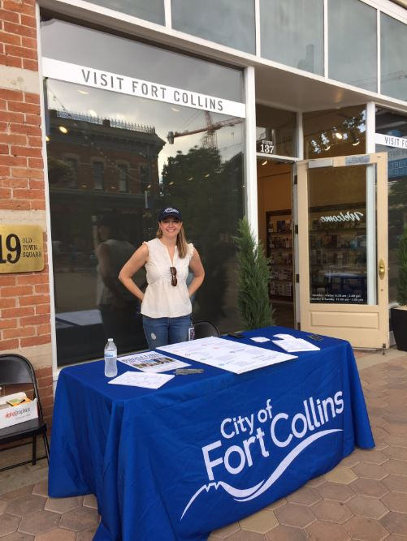
Meet People Where They Are
Connections
Partnering on events
Tailoring not just the message but the event & opportunity
Notes:
Spanish survey on tablet for Alta Vista outreach
West Nile Virus children’s activity
Budget Engagement – pin on boards exercise when updating strategic plan, mobile budget booths for BF
New Campaign to raise general awareness of existing channels, build identity of different channels (Nature vs. Transporation), create user generated content, build not only a sense of empowerment but responsibility in terms of civic engagement
Your: Volunteer (10,000 active volunteers), Access Fort Collins, Boards and Commissions, CityWorks 101
My: #MyFoCo, cultural centers and program such as art in public places
Our: #FoCoCreate, CityView
Our City engagement platformm just launched includes analytics and reporting and a variety of engagement tools from questionnaires, mapping, videos, community driven discussion boards, and more

Slide 13
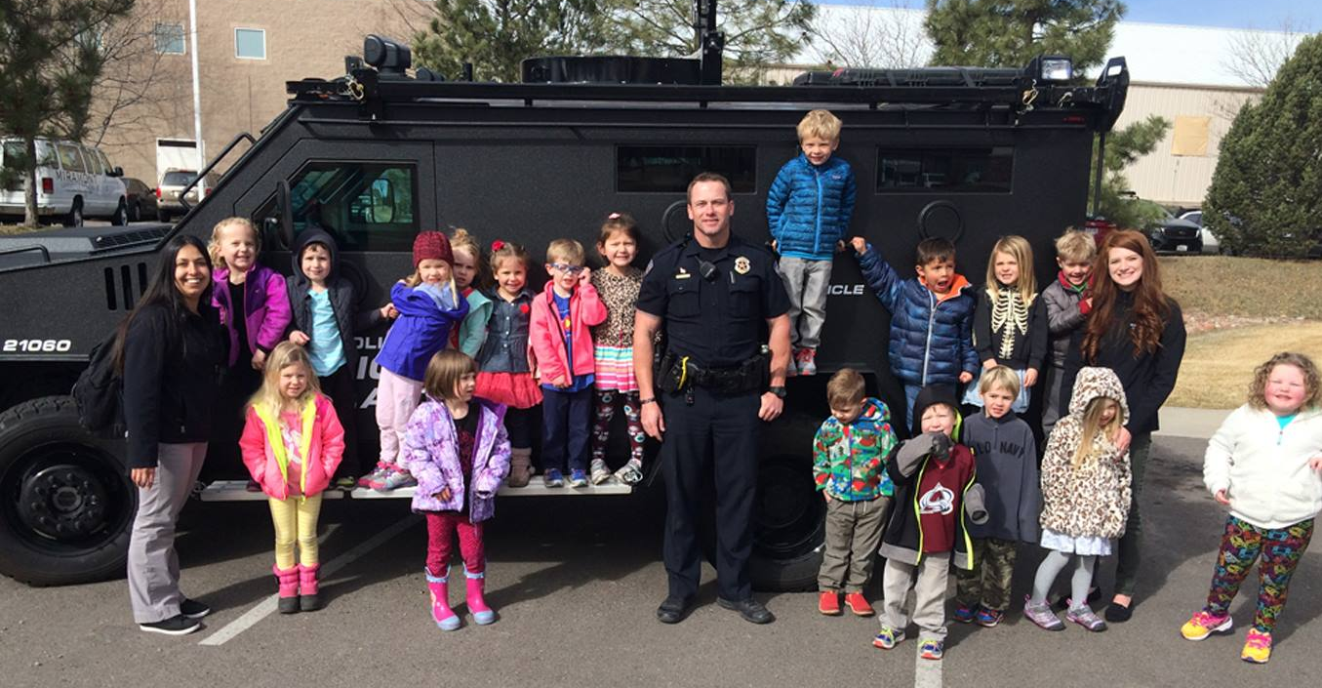
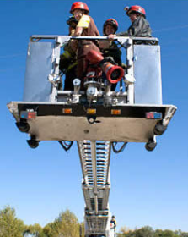
Examples of Engagement
Doc’s Birthday
Preschoolers explore the SWAT BearCat
CityWorks 101 students take a ride

Slide 14
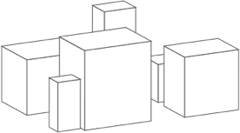
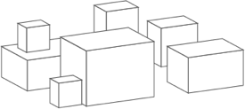
Your Organization – Their Platform
Create the structure that allows for success
Front end work
Build a culture that treasures and hires their volunteers
What experience does your target group want or need
Rewards and incentives
Internships or mentorship
Notes:
Our Mission is to Provide:
Best power
Best utility
Fast internet
Diverse economy
What platform does your organization provide?
Appeal to people that will come to this community and co-create with us and other community members
Continuous organic improvement driven by everyone

Slide 15
Outreach Activity
Small/table groups (5 minutes)
Establish record keeper
Each table has hard to reach groups on slips
Discuss their degrees of separation/barriers to volunteering, any personal experience? (10 minutes)
Choose three to Interest Map (10 minutes)
CHOOSE ONE for communication plan creation (15 minutes)
Add title, small summary, etc. to board
Share your project
Notes:
Stakeholders usually people with power or influence in this case often in making final decisions, financial support, in this case their power is their time, and your organization needs it
Map stakeholders, priorities but we’re going to shift slightly and map our hard to reach groups and then make plans for each of them
Small smallis groups since we are a big group – seven groups of five
Secret feedback!!!
Has anyone done something similar? If so what did you learn from it.
What would you add?

Slide 16
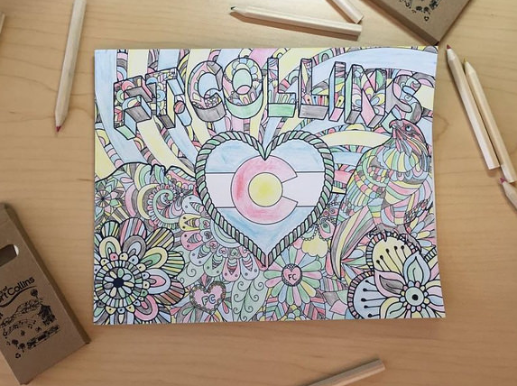
Low Hanging Fruit and Incentives
“How did you hear about us?” on all application processes
How can they come to you?
Exit surveys (paper and online)
Include demographics questions
Snowball recruitment
Table at fairs
Children’s Activities
Notes:
Anytime you try something you get information. Google analytics, backend data generated by ad campaigns
provide three additional contacts, gift card if one volunteers and repeat
(someone else put a giant event together filled with people and local fairs are often affordable for vendors)
Would be great to say, you’ll make the world a better place boom motivation but think a little more targeted in terms of cultural and target audience incentives
High school students – gift cards, shadowing opportunities,
60+ - service exchanges,
Clearly state their role volunteers for advisory groups, we need to make sure they know exactly who they will be advising and their level of influence, the fastest way to break trust or lose an audience is to engage them for something and then make them feel like their time was wasted

Slide 17
Key Takeaways
Data and Records
Map interests and prioritize
Try new tools and follow trends
If you find them, keep them (or their friends)
Ask for help (partnerships)
Don’t think rescue (beyond “save the world” messaging)
Recognize your existing volunteers
Notes:
Get beyond save the world messaging – not personal, too big, daunting, don’t see how they will make a difference, believe they will do good on the level they are interested in
WORD OF MOUTH

Slide 18
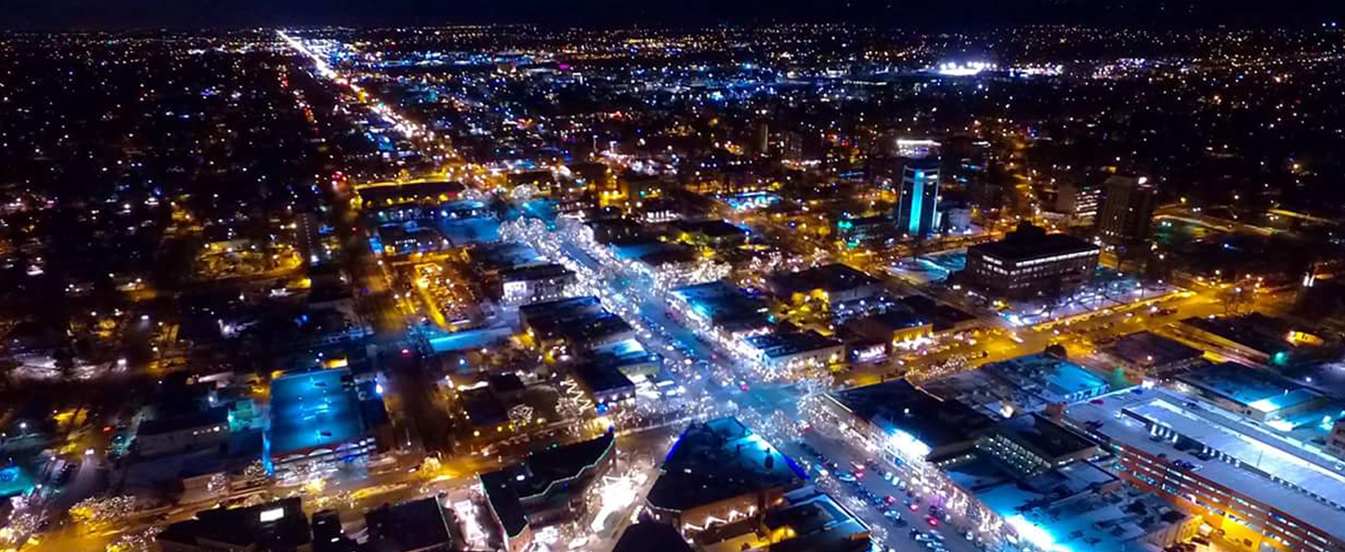
Thank You!

